Slide 1
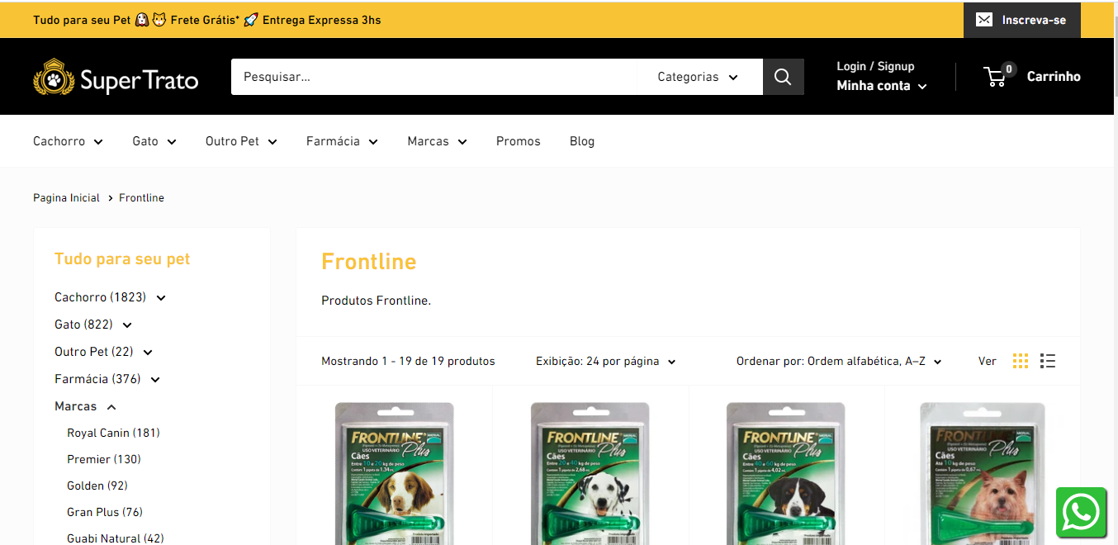
https://supertrato.pet/collections/frontline?sort_by=title-ascending
Evento page view - Pixel_pageview_Super Trato

Slide 2
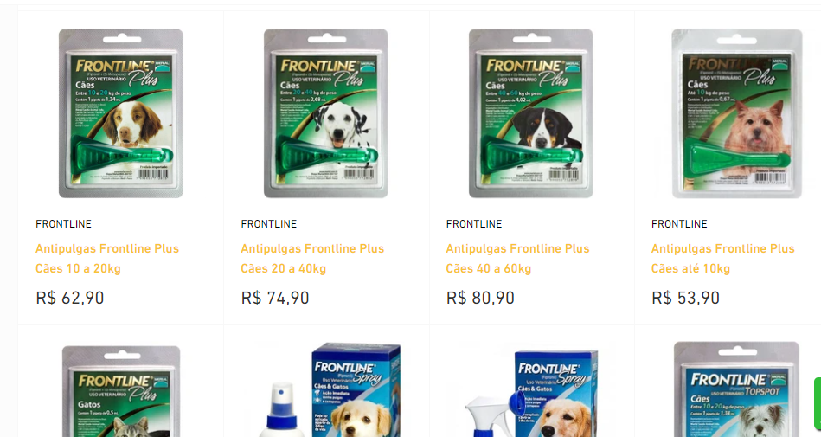
https://supertrato.pet/collections/frontline?sort_by=title-ascending
Evento adicionar ao carrinho
Em todos os produtos frontline do site

Slide 3
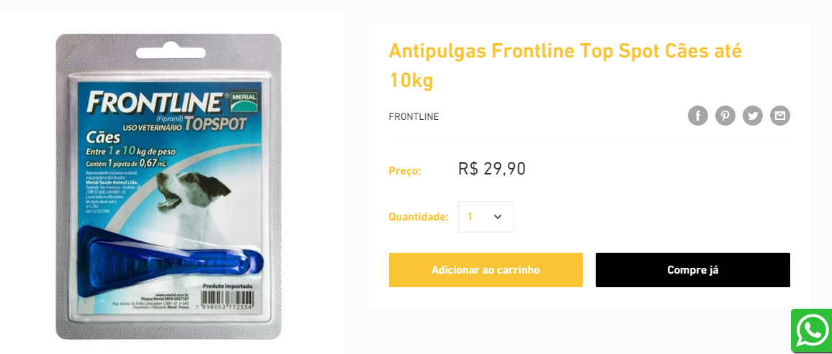
https://supertrato.pet/collections/frontline/products/antipulgas-frontline-top-spot-caes-ate-10kg
Evento Finalizar compra

Slide 4
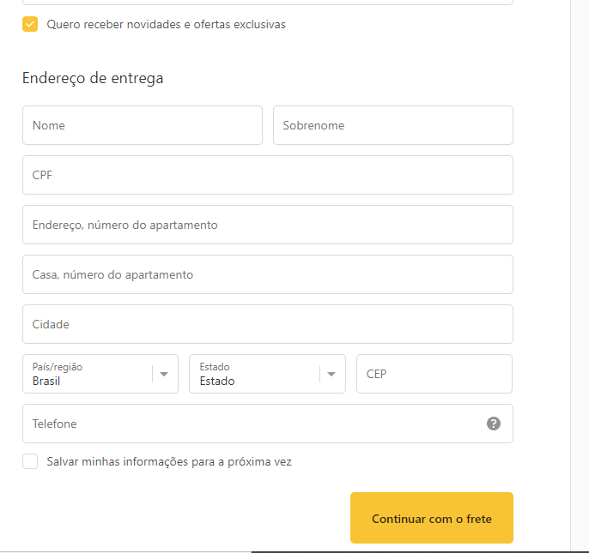
https://supertrato.pet/8593047629/checkouts/1be37448f351605921dfd229664e1014?skip_shopify_pay=true&locale=pt-BR
Evento Finalizar compra

Slide 5
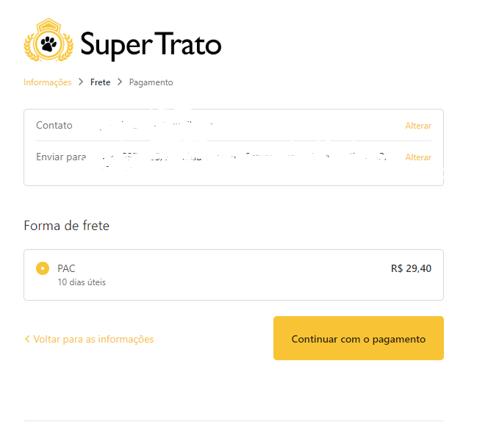
https://supertrato.pet/8593047629/checkouts/1be37448f351605921dfd229664e1014?previous_step=shipping_method&step=payment_method
Evento Finalizar compra

Slide 6
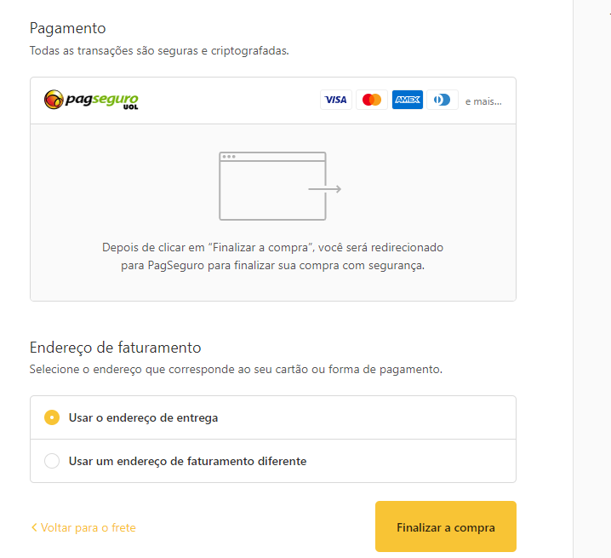
https://supertrato.pet/8593047629/checkouts/1be37448f351605921dfd229664e1014?previous_step=shipping_method&step=payment_method
Evento compra realizada

